Slide 1
PADLET ACTIVITY- 5 MINUTES- Once the music stops we will begin
GO TO MRS LOUIFAITES PADLET AND READ HER 2 TRUTHS AND A LIE ABOUT HER.
CREATE YOUR OWN TWO TRUTHS AND A LIE ABOUT YOURSELF ON THE PADLET. YOU MAY TAKE A PICTURE WITH YOUR CAMERA AND UPLOAD IT TO YOUR RESPOND( This helps you become comfortable with technology tools)
You can access the link to the padlet 2 ways:
https://tinyurl.com/y3tqo7e9
Or locating the link on your Digital Learning Session Resources

Slide 3
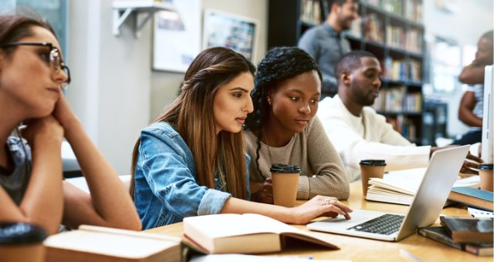
VIDEO: WHAT TYPE OF LEARNER ARE YOU?

Slide 4
VIDEO RESPONSE USING MICROSOFT FORMS DOCUMENT
Now that you have watched the video we will reflect on what type of online student you are.
To access the Microsoft Forms Response
You may type in the following URL to be taken there directly
https://tinyurl.com/y4rh4s8o
2. You may locate the link under session resources for the Digital Session “The Hunt is On”

Slide 5
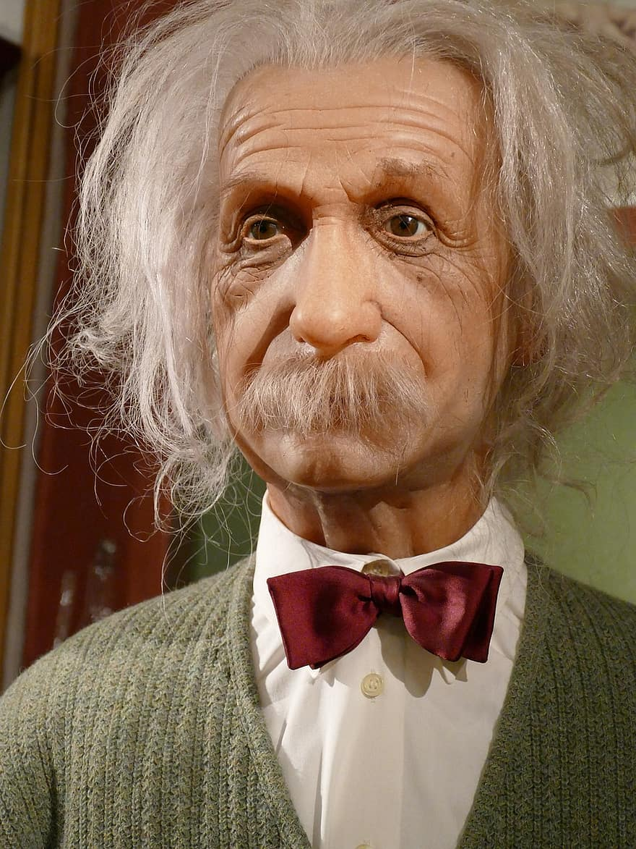
Directions: Complete all 9 tasks linked from this page before Friday, 8/28.
Brain
Break
Survey
Says
Teacher Talk should be the last thing you do!
Bank
Roll
Toolbox
Info only
Science
Interests
Science game
Challenge
Community
Connection
Science
Team
Hint: Click the home icon to return to this page.

Slide 6
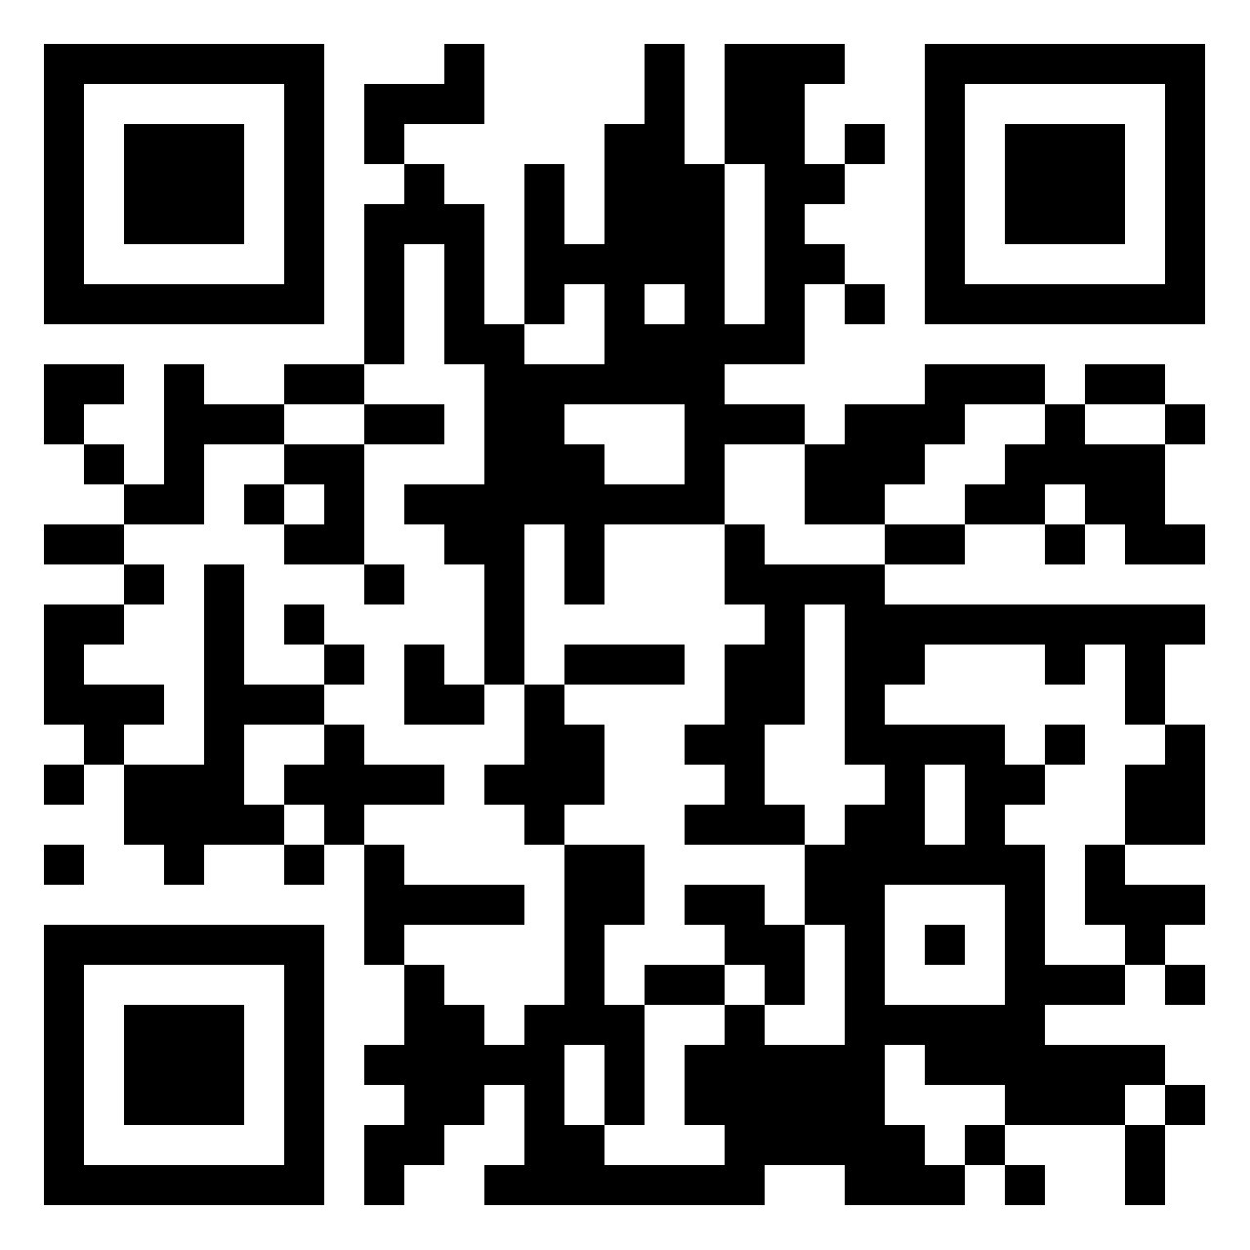
Brain
Break
Directions:
Vist the following website and complete the Learning Style Quiz: https://www.how-to-study.com/learning-style-assessment/
According to the website, what is your dominant learning style?
Knowing this, list three (3) ways that you can use this information to help you (in your own words).
Join Padlet to share your answers for #2 & #3 (link: https://padlet.com/karla_stuber/cqz4sauiwqilivu4 )
Link to Padlet

Slide 7
Bank
Roll
Directions:
In order to be successful in any class, you need to be able to know what’s expected of you. Read through your teacher’s syllabus (click here for syllabus) for class rules and information, then answer the questions provided in the Forms (click here for on Microsoft Forms)

Slide 8
Directions:
The more a teacher knows about you, the better the class is going to be!
Click here to access the student interest survey, answer all the questions, and then submit.
Survey
Says!

Slide 9
Directions:
An important part of being an online community is making sure you’re a great digital citizen.
Read the Email Etiquette and the Live Expectations guidelines.
Send your Science teacher a proper e-mail about how you will be a responsible digital citizen (you can e-mail your teacher through CTLS).
Community
Connection

Slide 10
Directions:
What’s in your toolbox?
In our new world of online learning, it is important to be a successful and smart digital citizen. We want you to think about how and why it is important to communicate appropriately in our online world.
Complete the Nearpod lesson on Digital Life 101. (Nearpod Code if needed:( CBSQH)

Slide 11
Directions:
What interests you or fascinates you about science? So many areas of life relate to science that many of us don’t even think of. If you were given the opportunity to really explore a topic what would it be? Underwater creatures? Diseases? Computers? Natural Disasters? Car engines? Medicine? All these things relate to science and so many, many more.
Make a short Flipgrid video telling your teacher 3 things in science that really interest you.
Be sure to include your name, and at least 3 things or topics you are interested in. We can’t wait to hear.
Science
Interests

Slide 12
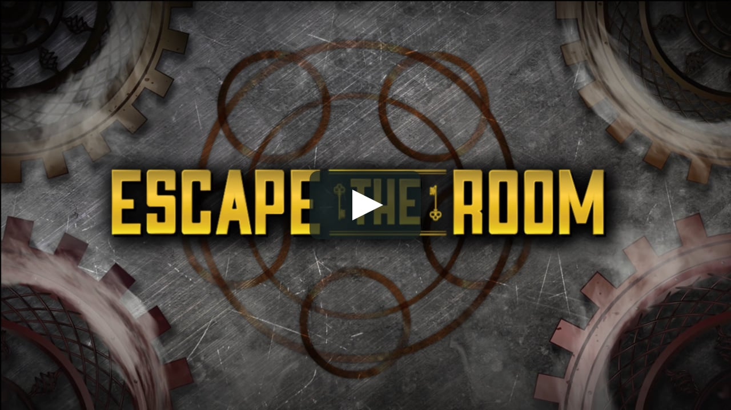
Your teacher may choose to assign a game for practice, review or assessment. Two that you may be familiar with are Kahoot and Quizizz. Both are game-based platforms and are available for both computers and smartphones. You can download
Apps on your phone for both.

Slide 13
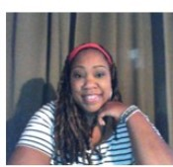
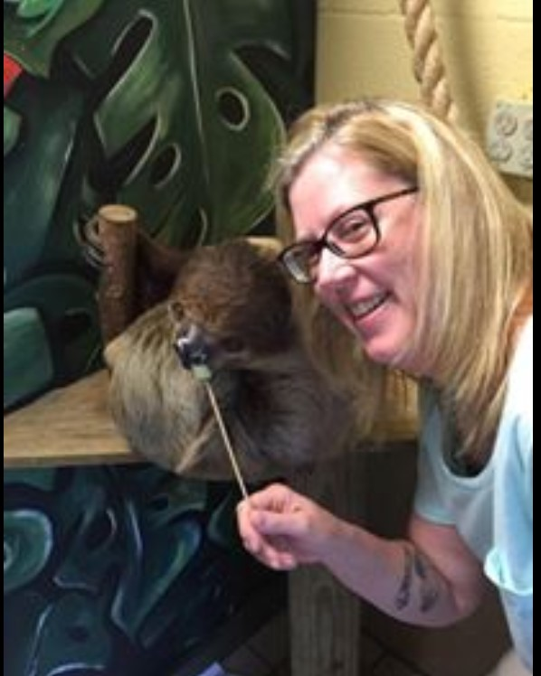
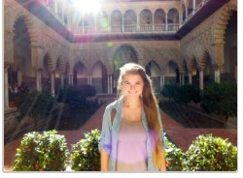
Directions:
For this task:
Find your Science teacher’s picture below.
Complete the Kahoot challenge
Use either your computer or a smartphone
(download the Kahoot app first).
Please use your first and last name (no cute nicknames).
Some of you will have a co-taught class with both Ms. Stuber
and Mr. Burger or Ms. Walens and Ms. Woodward, however, your current schedule will only say Ms. Stuber or Ms. Walens, so use their codes. Thanks.
Ms. Louifaite
Ms. Stuber
Ms. Walens

Slide 14
Stuber
Kahoot link for computer
https://tinyurl.com/yxmcbjzu
Kahoot Game PIN for smartphone: 02167145

Slide 15
Walens
Kahoot link for computer
https://create.kahoot.it/share/enter-kahoot-title/20f8f441-1b32-424d-a5d8-ac94a021a42f

Slide 16
Louifaite
Kahoot link for computer
https://kahoot.it/challenge/0887275?challenge-id=3498799b-68bf-4e65-a1cf-0eb9b64a80f2_1597777631927

Slide 17
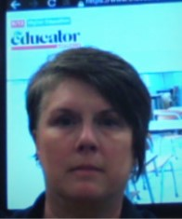
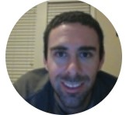
KNOW YOUR SCIENCE TEAM
Science
Team
It would behoove you (meaning it would benefit you) to know the entire Smitha 8th grade Science team. Someday you may need help when your teacher is not having office hours (none of us are available 24/7) at which point you could turn to another teacher. We are all here to help.
Read through the next 5 slides and then take a quiz to see what you’ve learned.

Slide 18
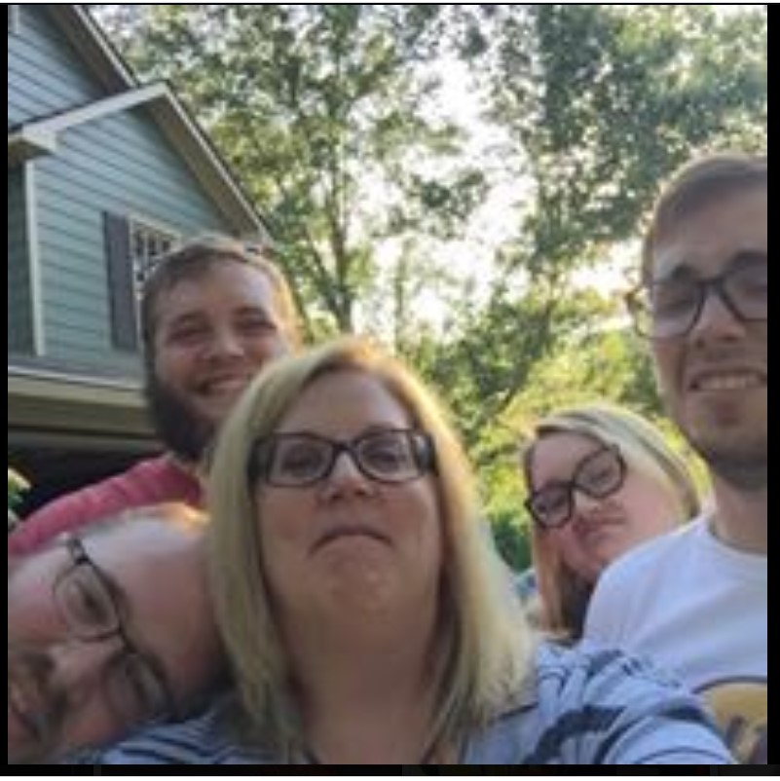
MS. STUBER
Ms. Stuber was born and grew up in Minneapolis, Minnesota. She has been to college in Minnesota but got her Bachelor in Education at KSU and her Master’s at Liberty University. She has 4 wonderful adult children and a fantastic boyfriend, oh and 2 crazy cats. The most beautiful place she has ever been is Tortola in the British Virgin Islands and wants to go again. Her favorite book(s) are the sci-fi series Red Rising by Pierce Brown. She rarely watches TV but loves movies. Her favorites are the Harry Potter movies and she wants to live in Hogwarts and teach Defense Against the Dark Arts.

Slide 19
MS. WALENS
Ms. Walens grew up in Cobb County. She went to Florida State University and got a degree in Biology and Science Education. She has 2 dogs she loves. She also has 5 nephews and 1 niece. Her favorite place to go is Virginia to see her sister and all of her kiddos! Ms. Walens favorite movie is called La Grande Beliezza and her favorite book is Slaughterhouse Five by Kurt Vonnegut. Ms. Walens also loves computer science and coding. She has been taking coding classes at Georgia Tech and she sponsors the Girls Who Code club at Smith. Let her know if you want to join!

Slide 20
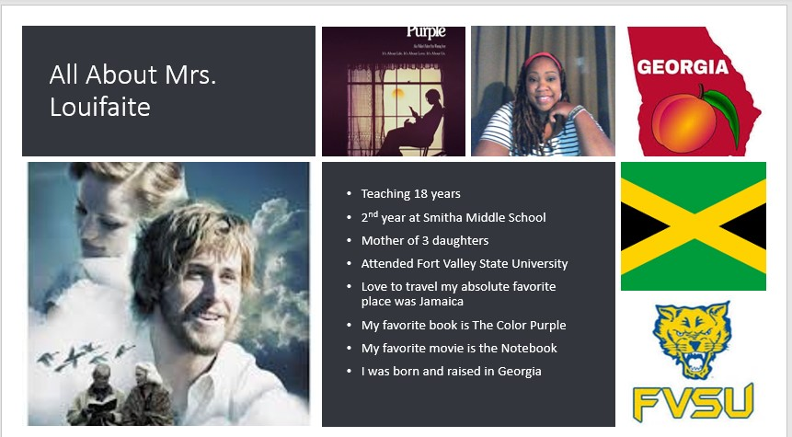
MS. LOUIFAITE

Slide 21
MR. BURGER
Mr. Burger has been teaching for 11 years, and has taught at Smitha for 7. He went to college at Penn State University and Kennesaw State University. He loves music (rock, bachata, reggaeton) and tv (Money Heist, The Wire). He loves to travel outside the US and has been to Russia, Scotland, Malta, Mexico, Honduras, Belize, and many other places. He has two boys, Tristan (3.5 years old) and Torrian (1 year old).

Slide 22
MS. WOODWARD
Ms. Woodward is a Cobb County native. She went to Hollydale, Tapp, and McEachern Schools. In fact, she lived on Tiffany Drive right beside the school from us!
Ms. Woodward likes camping and being out of doors. She has 3 daughters and lots of pets that they keep bringing home. Some of you probably surprised that she is now in 8th grade!!

Slide 23
NAME THAT TEACHER!
If you have landed here, read the 5 slides before this to
Take the quiz and find out how well you know the 8th grade Science team. Choose the best answer for each question.
https://quizizz.com/join?gc=60387328
Or you can go to quizizz and use the code
60387328

