Slide 1
NOTEBOOK SET UP
ON THE OUTSIDE OF YOUR NOTEBOOK PUT YOUR FIRST AND LAST NAME, PERIOD, TEACHER AND SUBJECT
FIRST PAGE OF YOUR NOTEBOOK CREATE A COVER PAGE THAT SAYS UNIT 1: OUT IN SPACE
WE WILL USE THE NOTEBOOK TO TAKE NOTES OF IMPORTANT THINGS THAT YOU MAY NEED TO REFER BACK TO WHILE IN SCIENCE CLASS
This Photo by Unknown Author is licensed under CC BY-NC-ND

Slide 2
Answer questions a-e in your notebook

Slide 3
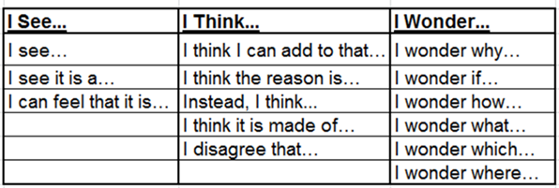

Slide 4
RIDING THE GRAVITRON-Use a piece of paper to write down predictions concerning the Gravitron. Divide your paper into sections of see, think, wonder

Slide 5
YOUTUBE VIDEO OF GRAVITRON AMUSEMENT PARK RIDE

Slide 6
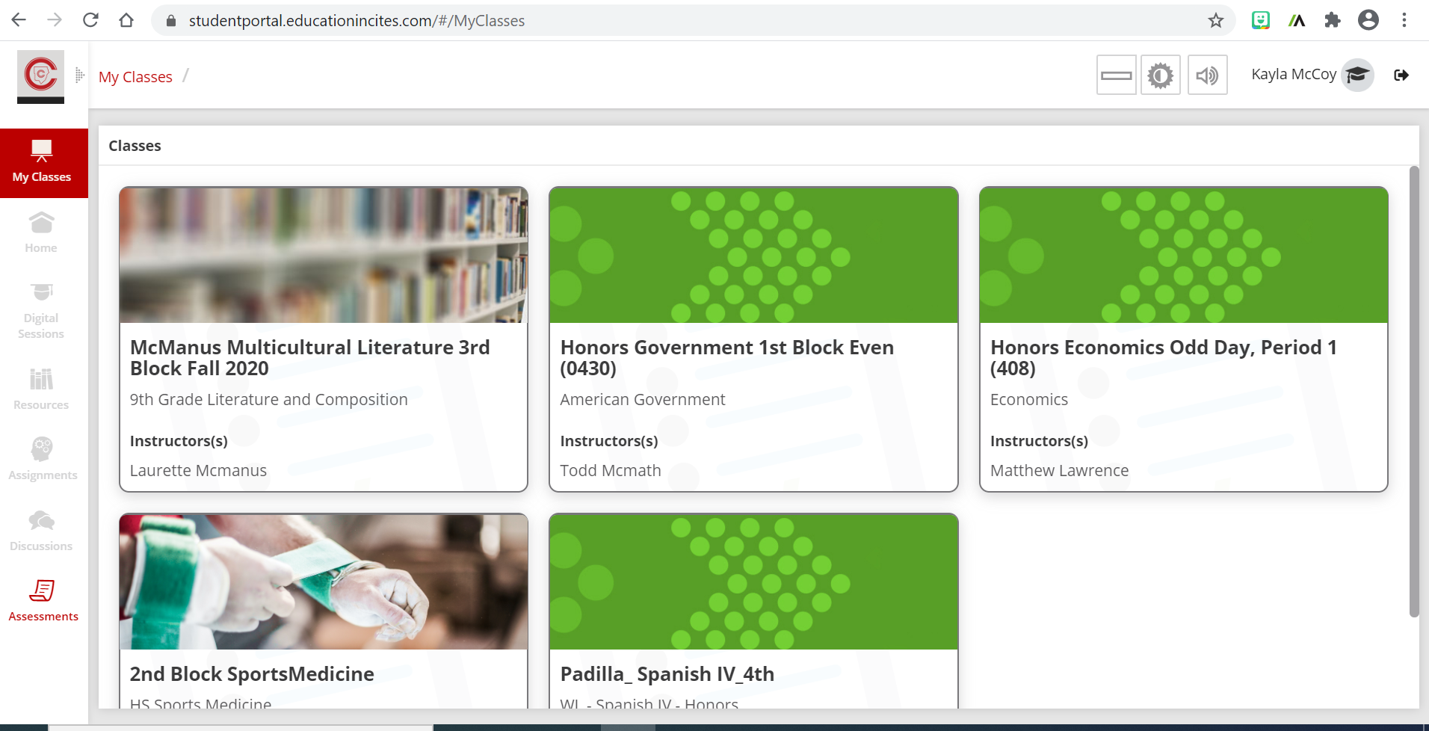
Finish Pre- assessment for topics in Unit 1-Astronomy
Click on the assessment section of your digital learning platform

Slide 7
Pre-assessment continue
Once you are in the assessment portal complete the following task
Locate and Click the Assessment that says Unit One Assessment –OUT IN SPACE with Mrs. Louifaite Name
Complete the 20 question assessment. The assessment only shows what you know about these topics before teaching

Slide 9
Introduction to Gravity and Inertia
WATCH THE STUDY JAMS VIDEO BY CLICKING ON THE PICTURE BELOW
AFTER WATCHING THE Study Jams VIDEO PLAY A QUICK GAME OF KAHOOT to Review

Slide 10
https://cobbk12org-my.sharepoint.com/:w:/g/personal/demetra_louifaite_cobbk12_org/Ea9w267_eQFMi8fWIjpJVZsBamA8tEVdbgpbNggbP1bZAQ?e=jWyc2H
Please make sure you open the typeable link above and use it to give the causes and effects of gravity and inertia after watching the video
Important :please save a copy to your own device before typing, if not you will type over someone elses answers as the link is shared. You will submit the Document you saved to your folder on CTLS when you are finished. You will see the assignment points will be given for turning it in

