Slide 1
Claim, Evidence, & Reasoning (CER)
Writing Scientific Explanation

Slide 2
SETTING UP YOUR NOTEBOOK FOR SCIENCE
Write your First and last name on the outside
Place Physical Science on the outside.
Place your period on the outside
With a pen or colored pencil create a cover page that says UNIT 1 Matter

Slide 3
SCIENCE OPENER-CER WRITE IT IN YOUR NOTEBOOK
WHAT DOES IT MEAN TO BE CURIOUS ABOUT SOMETHING?
Can you make predictions(claims about why things happen even before they happen)
Can you use facts, observations to declare evidences about what you see
Can you back up your evidence and justify it with valid reasons as to why you think evidences are occurring?

Slide 4
Curiosity Mars Rover
Let’s watch a video…..
https://www.youtube.com/watch?v=oHLbXTOaw7w&feature=youtu.be
*As you watch this video, keep these questions in mind.
What are the scientists curious about - what do they want to know?
What data will the rover recover?
How will the data help the scientists answer their questions?

Slide 5
What is a Scientific Explanation?
Claim Reasoning Evidence
What do you know?
How do you know that?
Claim + Evidence + Reasoning
= Explanation
Why does your evidence support your claim?

Slide 6
Question: What do you want to know?
Claim:
A statement that answers your question
Evidence:
Scientific data that support the claim
Data need to be appropriate (graphs, pictures, tables)
Observations
Reasoning: (how your evidence justifies your claim)
Based on scientific principles
Each piece of evidence may have a different justification for why if supports the claim

Slide 7
In class:
When? We use CER-based narratives after completing a lesson.
Why? CER-based narratives allow you to make connections between the lesson and the lab. Also, learning how to write in science is very important to your education as a whole.
How? CER-based narratives are set up in a paragraph form (usually 5-7 sentences in length). There are times when it is necessary to include a data table, graph, or picture in with your evidence.

Slide 8
Writing an Explanation
Question:..... WHO IS MY DAD?
Claim:
Evidence:
Reasoning:

Slide 9
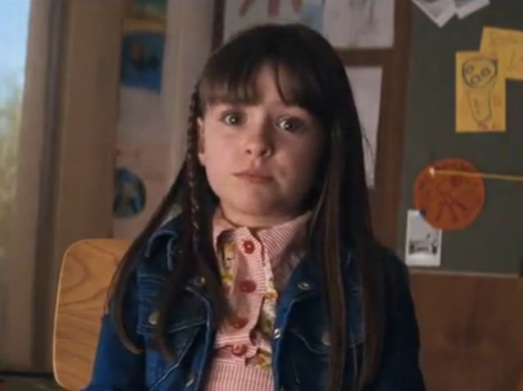
My Dad’s a Space Alien

Slide 10
I have evidence that proves my dad’s a space alien.
He speaks a weird language.
He drinks green stuff.
He says he’s from Albuquerque (I’m not buying it).
I mean, just look at him.
And one more thing. He has a space ship.
The evidence doesn’t lie.
My dad’s an alien.

Slide 11
Writing an Explanation
Who is my Dad?
Question:.....
Claim:
My Dad’s a Space Alien
Evidence:
He speaks a weird language
He drinks green stuff
He’s from Albuquerque
He dresses funny He drives a spaceship
Reasoning:
The evidence doesn’t lie...

Slide 12
Writing an Explanation
Question: Who is my dad?
Claim: My dad’s a space alien.
Evidence:
He speaks a weird language
He’s from Albuquerque
He drinks green liquids
He dresses funny
He drives a spaceship
Reasoning:
Aliens are not from Earth so they have their own language
Some people believe that aliens have landed in NM
Which is why many aliens are seen with green skin
Aliens wear space suits for protection
Aliens use spaceships for travel

Slide 13
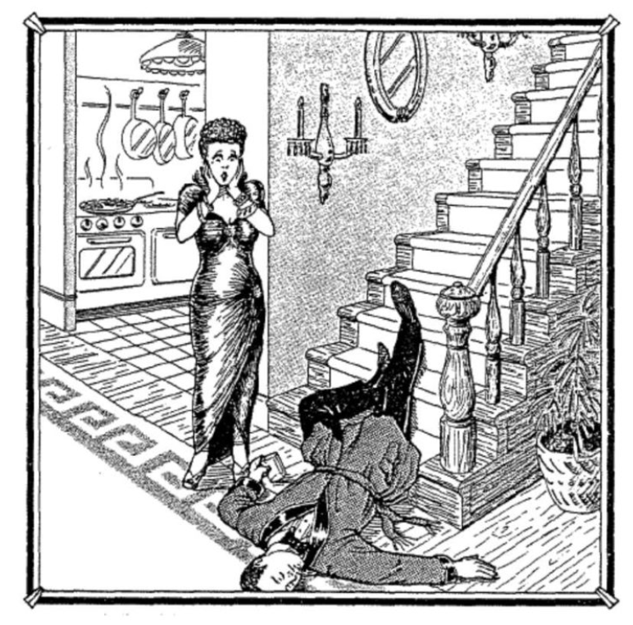
Another CER example and your homework
SLIP or TRIP (or who killed Arthur?)

Slide 14
Queen Volupides “story”
At five-feet-six (5’6”) and a hundred and ten (110) pounds, Queenie Volupides was a sight to behold and to clasp. When she tore out of the house after a tiff (fight) with her husband, Arthur, she went to the country club where there was a party going on. She left the club short before one in the morning and invited a few friends to follow her home and have one more drink. They got to the Volupides house about 10 minutes after Queenie, who met them at the door and said, “Something terrible happened. Arthur slipped and fell on the stairs. He was coming down for another drink - he still had the glass in his hand - and I think he’s dead. Oh, my God - what shall I do? The autopsy conducted later concluded that Arthur had died from a wound on the head and confirmed that he’d been drunk.

Slide 15
Things to consider….
Did Queenie’s husband Arthur slip? Or did he trip?
What evidence supports your claim?
Why does each piece of evidence support your claim (your reasoning)?
How can your position be refuted (disproved)?

Slide 16
Your Assignment
This will be a formative assessment to see how well you can create a CER with a claim, evidence, and reasoning.
Use the document in your Session Resources titled “Writing an Explanation”
Turn it in to Student Uploads
Using the Slip or Trip picture and the Queenie Volupides story, complete a CER.
What should our question be?

