Slide 1
Global and Local Winds

Slide 2
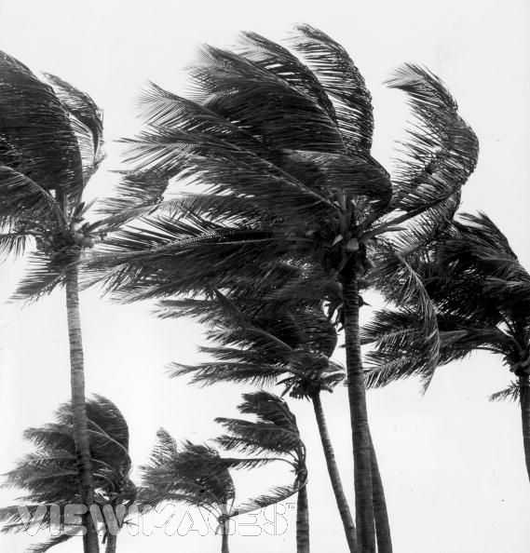
Winds
What is wind?
- Wind is the horizontal movement of air caused by difference in air pressure

Slide 3
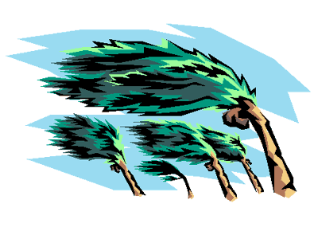
What causes winds?
Differences in air pressure
More of a difference in pressure = faster winds
Lots of difference

Slide 4
Why does Air Move ?
The movement of air caused by differences in air pressure is called Wind
Air moves from areas of higher pressure to areas of lower pressure
Differences in air pressure is caused by unequal heating of the earth
*the SUN is the major source of energy for heating that generates winds
Air at the equator is warmer and less dense so it rises creating an area of low pressure
At the poles, the air is colder and more dense so it sinks creating areas of high pressure
This cold polar air then flows towards the equator

Slide 5
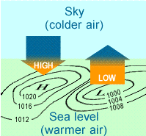
Air Rises @ Equator Air Sinks @ Poles
You know…
Warm air rises = less dense
Cool air sinks = more dense
Now understand…
Warm air = less dense
= low pressure
Cool air = more dense
= high pressure

Slide 6
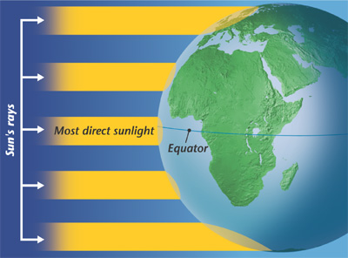
Global Winds
Created by unequal heating of Earth’s surface.

Slide 7
What is the Coriolis Effect ?
The apparent curving of the path of winds and ocean currents due to earth’s rotation is called the Coriolis effect
Because of the coriolis effect, in the Northern Hemisphere winds traveling north curve east ( clockwise) and winds traveling south curve west ( counterclockwise)
Flipped in the Southern Hemisphere

Slide 8
Global Winds… cont…
The unequal heating of Earth’s atmosphere by sunlight produces global winds.
The combination of high-pressure polar air + low-pressure equatorial air, and the Coriolis effect produce global winds.
The angle at which sunshine strikes Earth’s surface is MAINLY responsible for the unequal heating of Earth’s surface.

Slide 9
Global Winds
The global wind pattern is also known as the "general circulation" and the surface winds of each hemisphere are divided into three wind belts

Slide 10
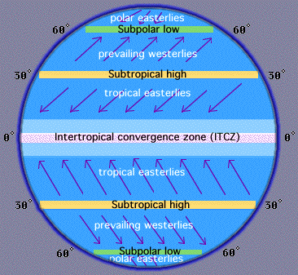
Global Winds
Polar Easterlies: From 60-90 degrees latitude.
Prevailing Westerlies: From 30-60 degrees latitude (aka Westerlies).
Tropical Easterlies: From 0-30 degrees latitude (aka Trade Winds).

Slide 11
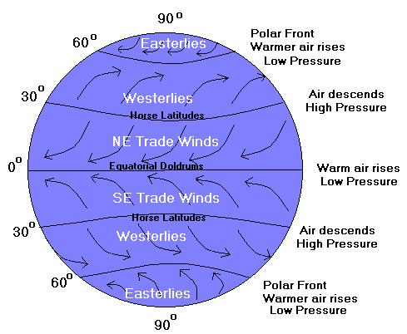
Doldrums
Where the trade winds meet around the equator
Very little wind because the warm air rising = low pressure

Slide 12
Horse Latitudes
High pressure areas… 30⁰N and 30⁰S
Very week winds

Slide 13
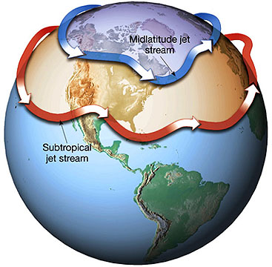
Jet Streams
Bands of high speed winds
Upper troposphere and lower stratosphere
Blow from west to east at speeds of 200-400 km/hr.
Help airplanes save fuel and time when traveling east.

Slide 14
Local Winds
Local Winds generally move short distances and can blow from any direction; caused by unequal heating of Earth’s surface within a small area
They are affected by the geographical features of an area, which can produce temperature differences that cause local winds
Types:
Sea breeze & land Breeze
Mountain breeze & valley breeze

Slide 15
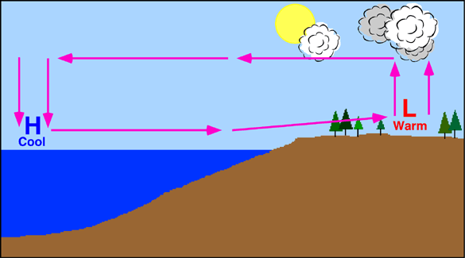
Sea Breeze (Morning)
Land heats up faster than water. Hot air over land rises (Low Pressure), cool air over water falls (High Pressure). Winds move from the water (High Pressure) to the land (Low Pressure).

Slide 16
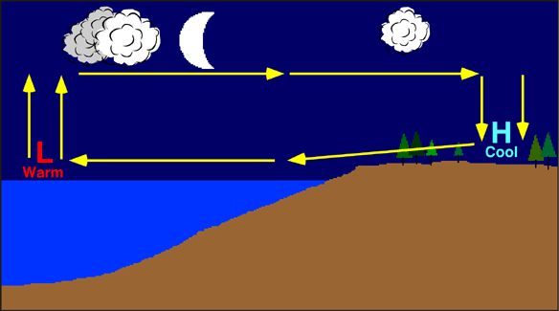
Land Breeze (Evening)
Land cools off faster than water. Cool air over land falls (High Pressure), warm air over water rises (Low Pressure). Winds move from the land (High Pressure) to the water (Low Pressure).

Slide 17
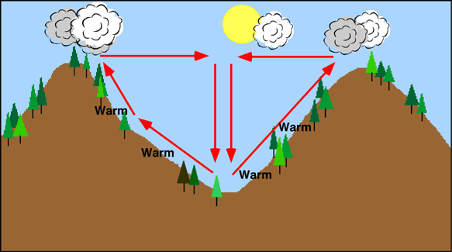
Valley Breeze (Day)
During the day the sun warms the air slopes, creating a valley breeze…
at nightfall, the air along the mountain slopes cools…

Slide 18
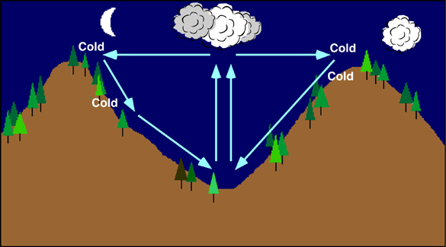
Mountain Breeze (Night)
This cool air moves down the slopes into the valley, producing a mountain breeze!

Slide 19
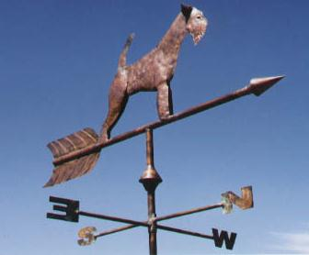
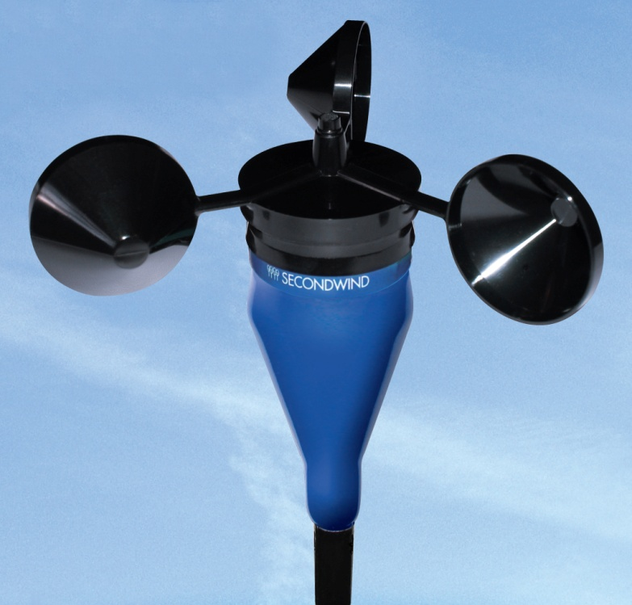
Measuring Wind
Wind Vane
Winds are described by their direction and speed.
Wind direction is determined with a wind vane – points in the direction the wind is moving!
Wind speed is measured with an anemometer.
The increased cooling that a wind can cause is called the wind chill factor.
Anemometer – The cups catch the wind, turning faster when the wind blows faster.

Slide 20
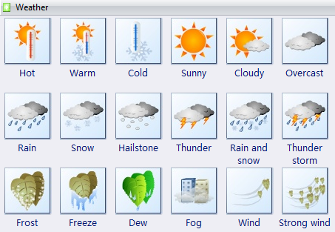
WEATHER results from differences in pressure, heat, air movement, and humidity.

Slide 21
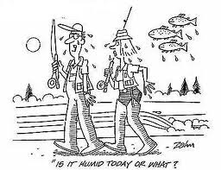
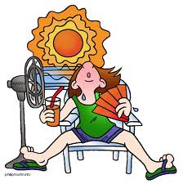
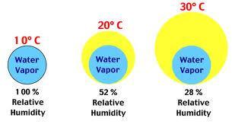
As water evaporates from lakes, oceans, and plants, it becomes water vapor, or moisture in the air. Water vapor is invisible. The amount of water vapor in the air is called HUMIDITY.
RELATIVE HUMIDITY is the amount of water vapor in the air compared with the maximum amount of water vapor that the air can hold at a certain temperature.

Slide 22
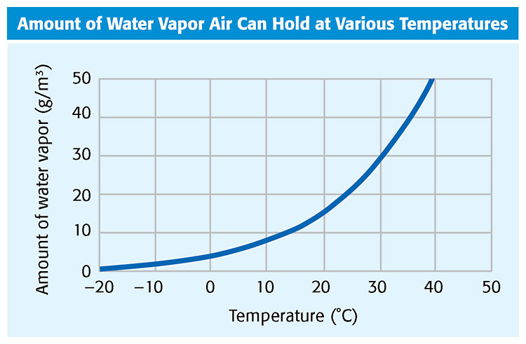
The Higher the Temperature, the More Water Vapor the Air Can Hold or the Higher Relative Humidity!

Slide 23
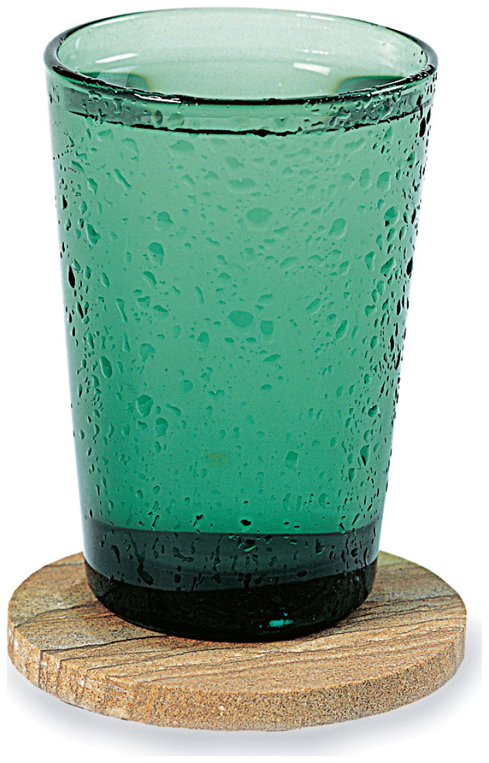
The dew point is the temperature at which a gas condenses into a liquid.
Condensation occurs when the air reaches 100% humidity
When the temperature of the air cools to its dew point, the air has reached saturation and condensation occurs.

