Slide 1
SCIENCE OPENER- Answer the questions in the chat session. We will share your responses
WHAT DO YOU THINK WOULD HAPPEN IF THERE WAS NO GRAVITY PRESENT ON EARTH? WHAT ABOUT IF THERE WAS NO GRAVITY PRESENT IN SPACE?
Think about the individuals that were riding the GRAVITRON

Slide 2
WHAT IS GRAVITY VIDEO- Click the video to watch what would happen if we had no gravity

Slide 3
PHET SIMULATION OF GRAVITY AND INERTIA (YOU MAY CLICK ON THE PHOTO TO SEE SIMULATION

Slide 4
GUIDED CORNELL NOTES FOR GRAVITY AND INERTIA. You may write this chart in your notebook and use the remaining slides to locate the answers
QUESTION(WRITE THE QUESTION IN YOUR NOTEBOOK) | Write your answers to the questions when you hear or locate them on this side
What scientist first discovered Gravity?
What does Newtons Law of Gravitation state
What 2 factors makes gravity stronger?
What happens to gravity if distance increases between objects?
What is inertia
What 2 factors combine to keep the planets moving and helps them stay out in space?
What would happen to the moon if there was no gravity or inertia

Slide 15
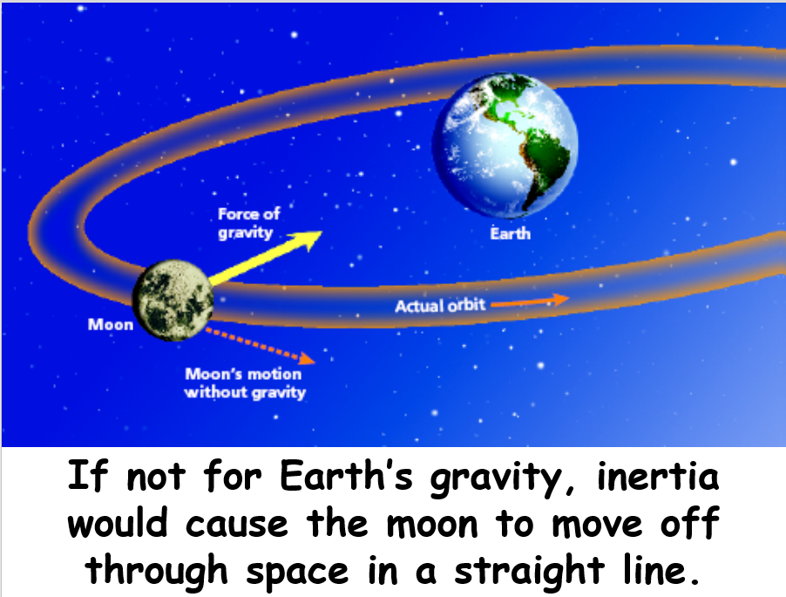

Slide 16
GRAVITY AND INERTIA STUDY JAMS VIDEO AND KAHOOT GAME REVIEW-Complete by Sunday August 30th
CLICK ON THE PICTURE TO WATCH THE VIDEO

Slide 17
ENRICHMENT ACTIVITY-CAN YOU EXPLAIN GRAVITY AND INERTIA Choose 1 and add it to your folder in CTLS save it as your first name /last name

Slide 18
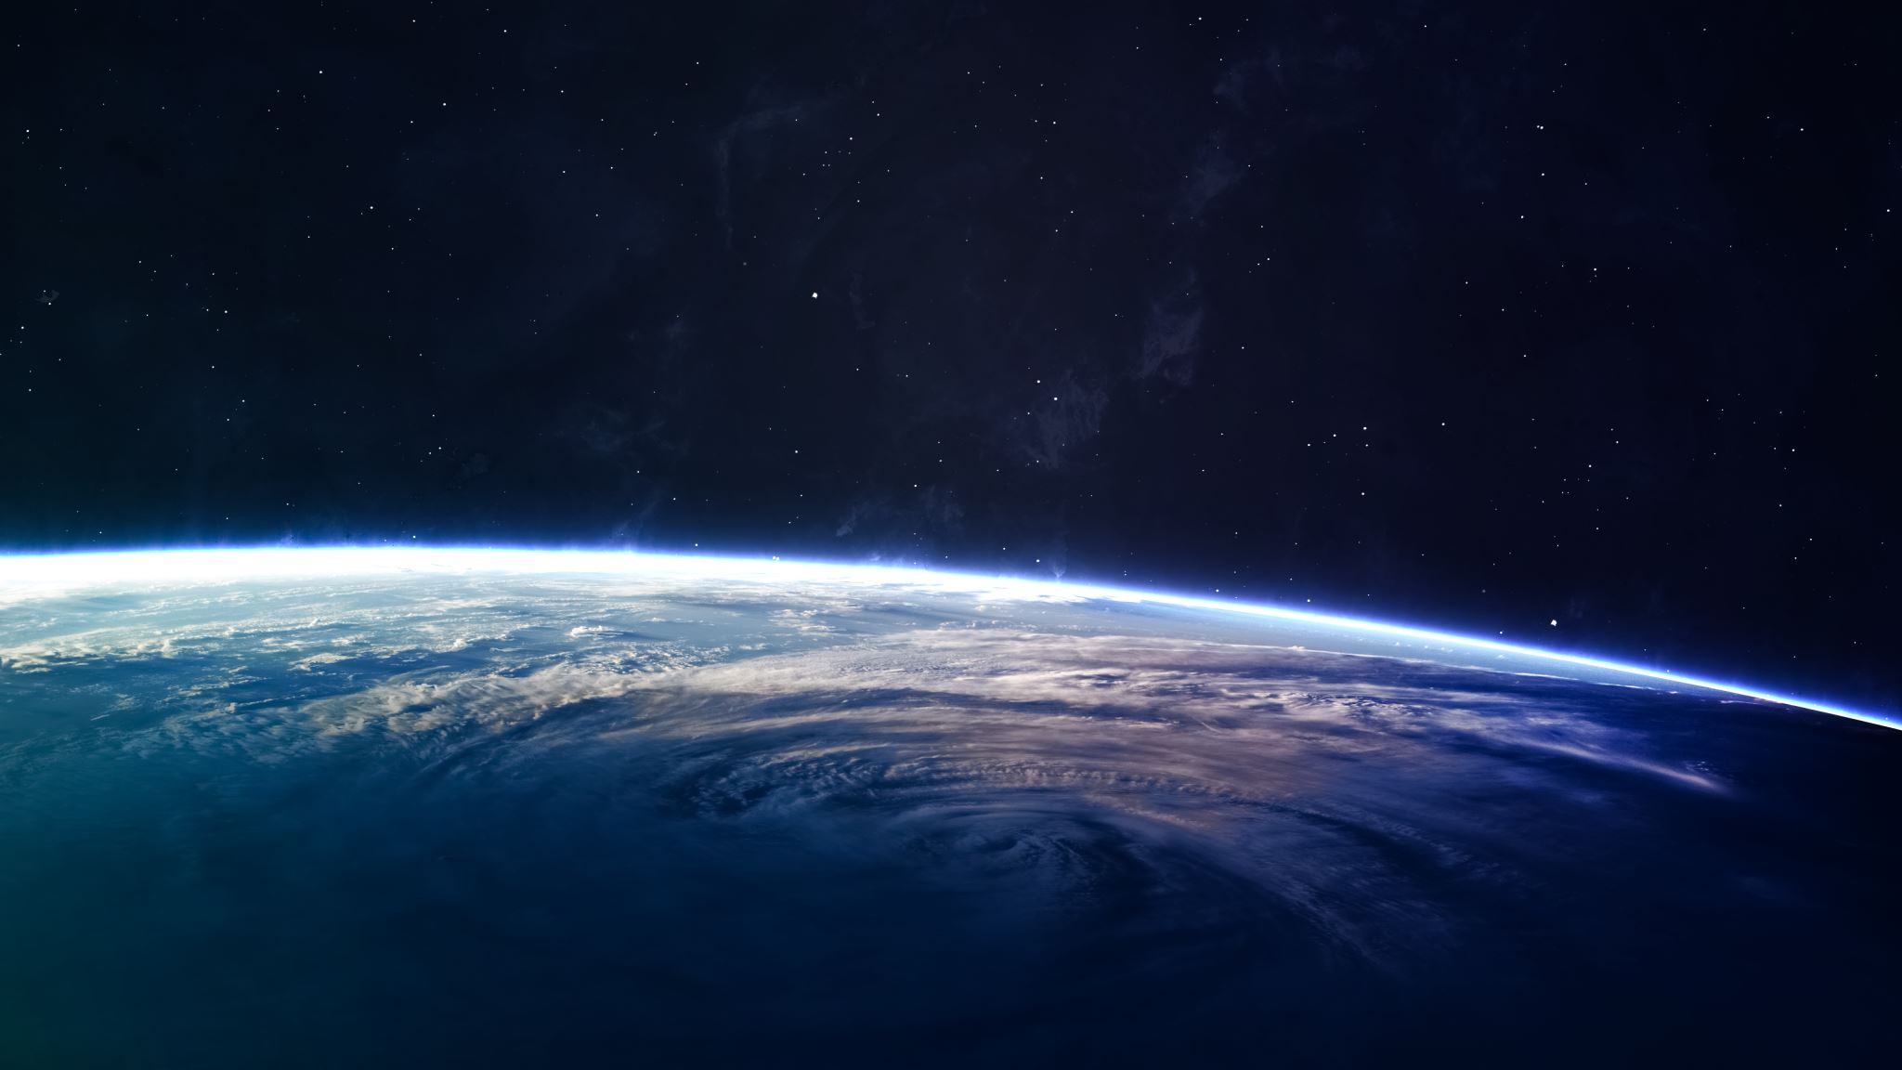
ADDITIONAL READING FROM NASA ON GRAVITY CLICK THIS LINK TO READ ABOUT GRAVITY FROM NASA

Slide 19
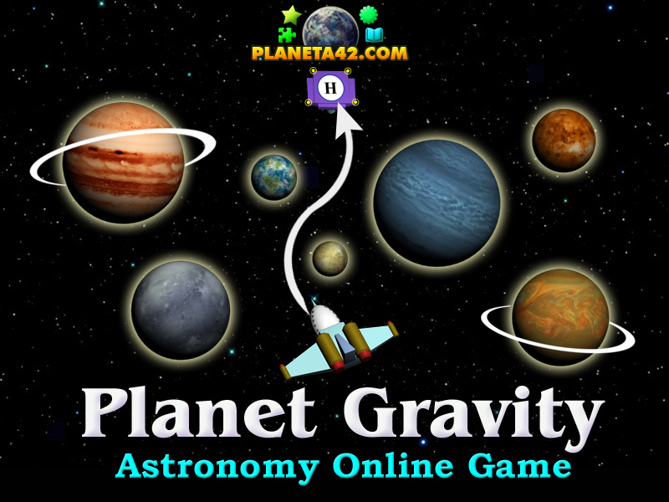
Extension- Gravity Review Game(Only complete when all work is done)

Slide 20
PRACTICE QUESTIONS FOR TEST

